Slide 1
Smart Security System
Adam Corbin, Stincii Dumerjean, Malia Kency, Jared Peterson

Slide 2
General overview
Basic security detection methods with PIR sensor
Intelligent scheduling linked up to Google Calendar
Arm/Disarm using hardware keypad & web user interface
Notifications
Live stream
Watson Graphs
Automated & remote testing

Slide 3
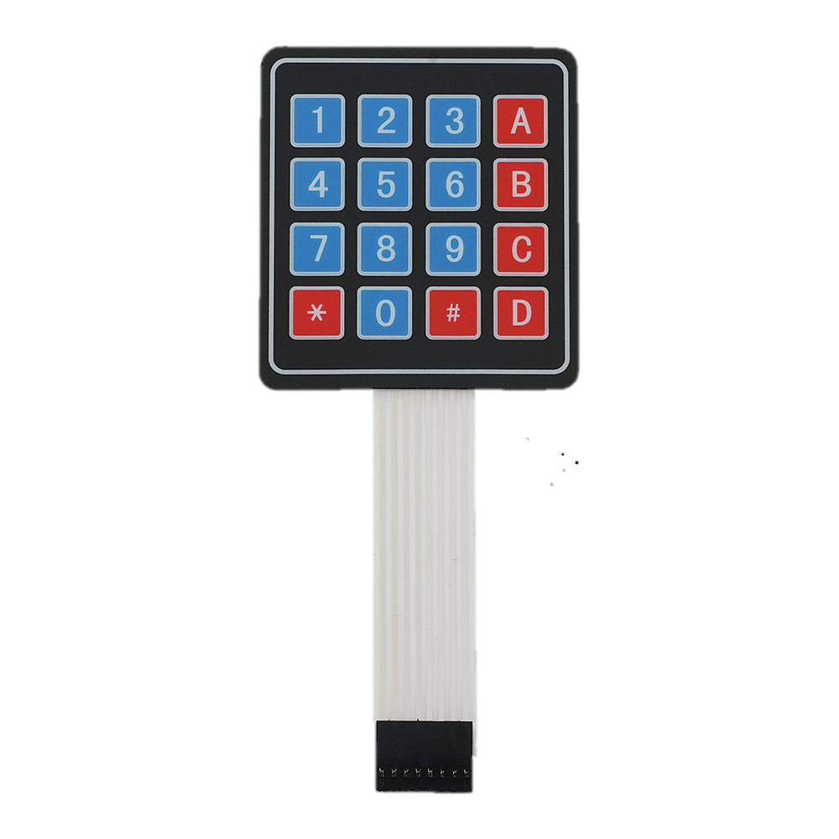
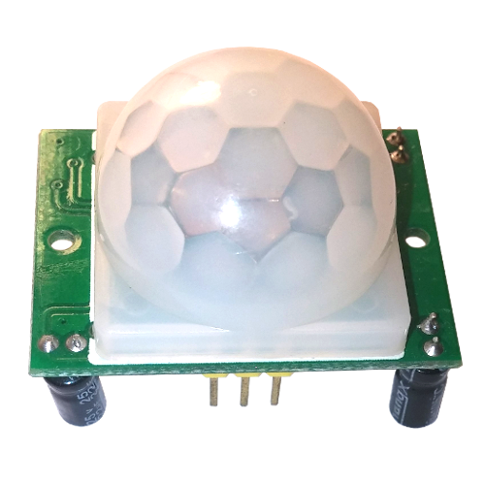

Inputs
HC-SR501 PIR(passive infrared) Motion Sensor
4x4 Matrix membrane switch
Google Calendar

Slide 4
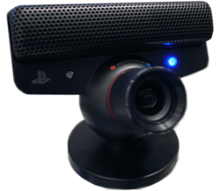
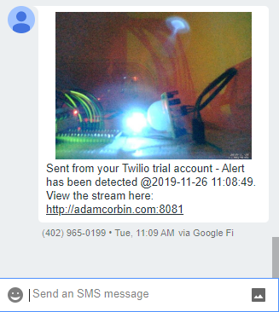
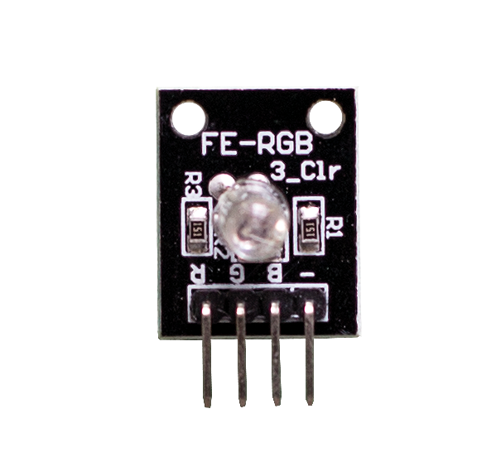
outputs
RGB LED Module
PS3 Eye camera video
Web user interface
MMS Notifications

Slide 5
services
Watson Graphs
Motion project library
Flask for UI
Twilio API for notifications
Google Calendar API

Slide 6
Demo – test scenarios
Keypad wrong code
Keypad enable – show led flashing
Trigger alarm
View MMS
View live stream
Disarm system
View UI to show status and test arming & disarming
View Watson graphs
Automated and remote testing

